Slide 1


Connecticut Insurance Complaints Analytics
William Lee, Devarshee Roy, Jainil Desai, Yasin Ahmed

Slide 2
Project Goal
Transform over 65,000 Department of Insurance (CT) complaint records into actionable intelligence for consumers, regulators, and carriers.
Key questions: Who responds fastest? Who pays fairly? How do we guide consumers for the best option for their needs?
Empower Connecticut consumers with transparent, evidence based rankings of insurance carriers, so they can choose companies that resolve claims quickly and pay fairly.
Equip regulators and legislators with hard numbers on complaint patterns, premium hike backlash, and anomaly clusters, guiding policy and targeted audits.
Demonstrate data-science analytics from raw CSV ingestion and unstructured dataset scraping through EDA, NLP methods, supervised & unsupervised modeling, and SHAP explainability.

Slide 3
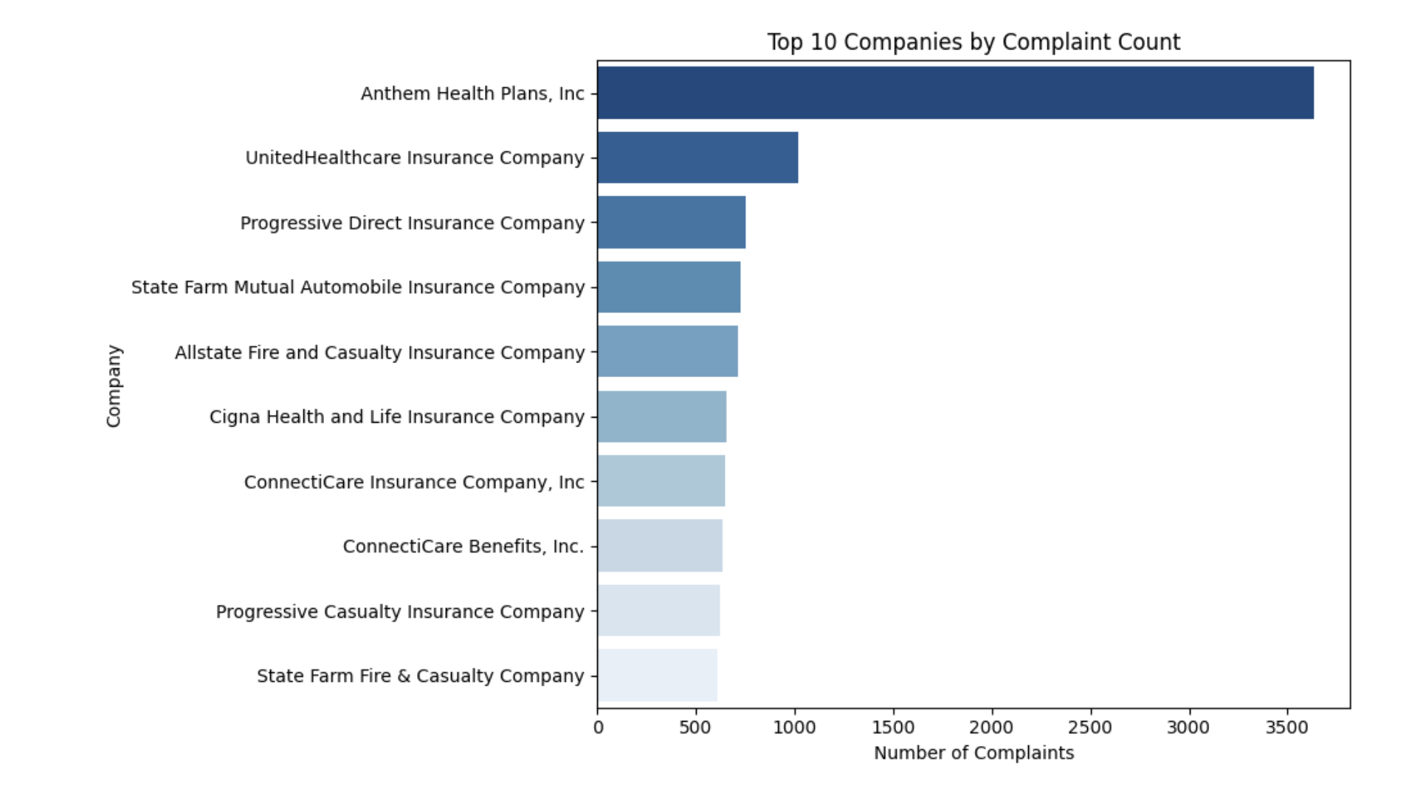

Dataset & Key Questions
Primary source: CT DOI ‘Insurance Company Complaints, Resolutions, Status & Recoveries’ (2008‑2025, 68,469 rows).
Core inquiries:
• Drivers of consumer recovery likelihood and amount.
• Company clusters by complaint volume, theme, resolution speed.
• Early detection of outlier cases likely to escalate or pay large sums.
• Did the premium spikes in long term care policies trigger a surge in consumer complaints?

Slide 4
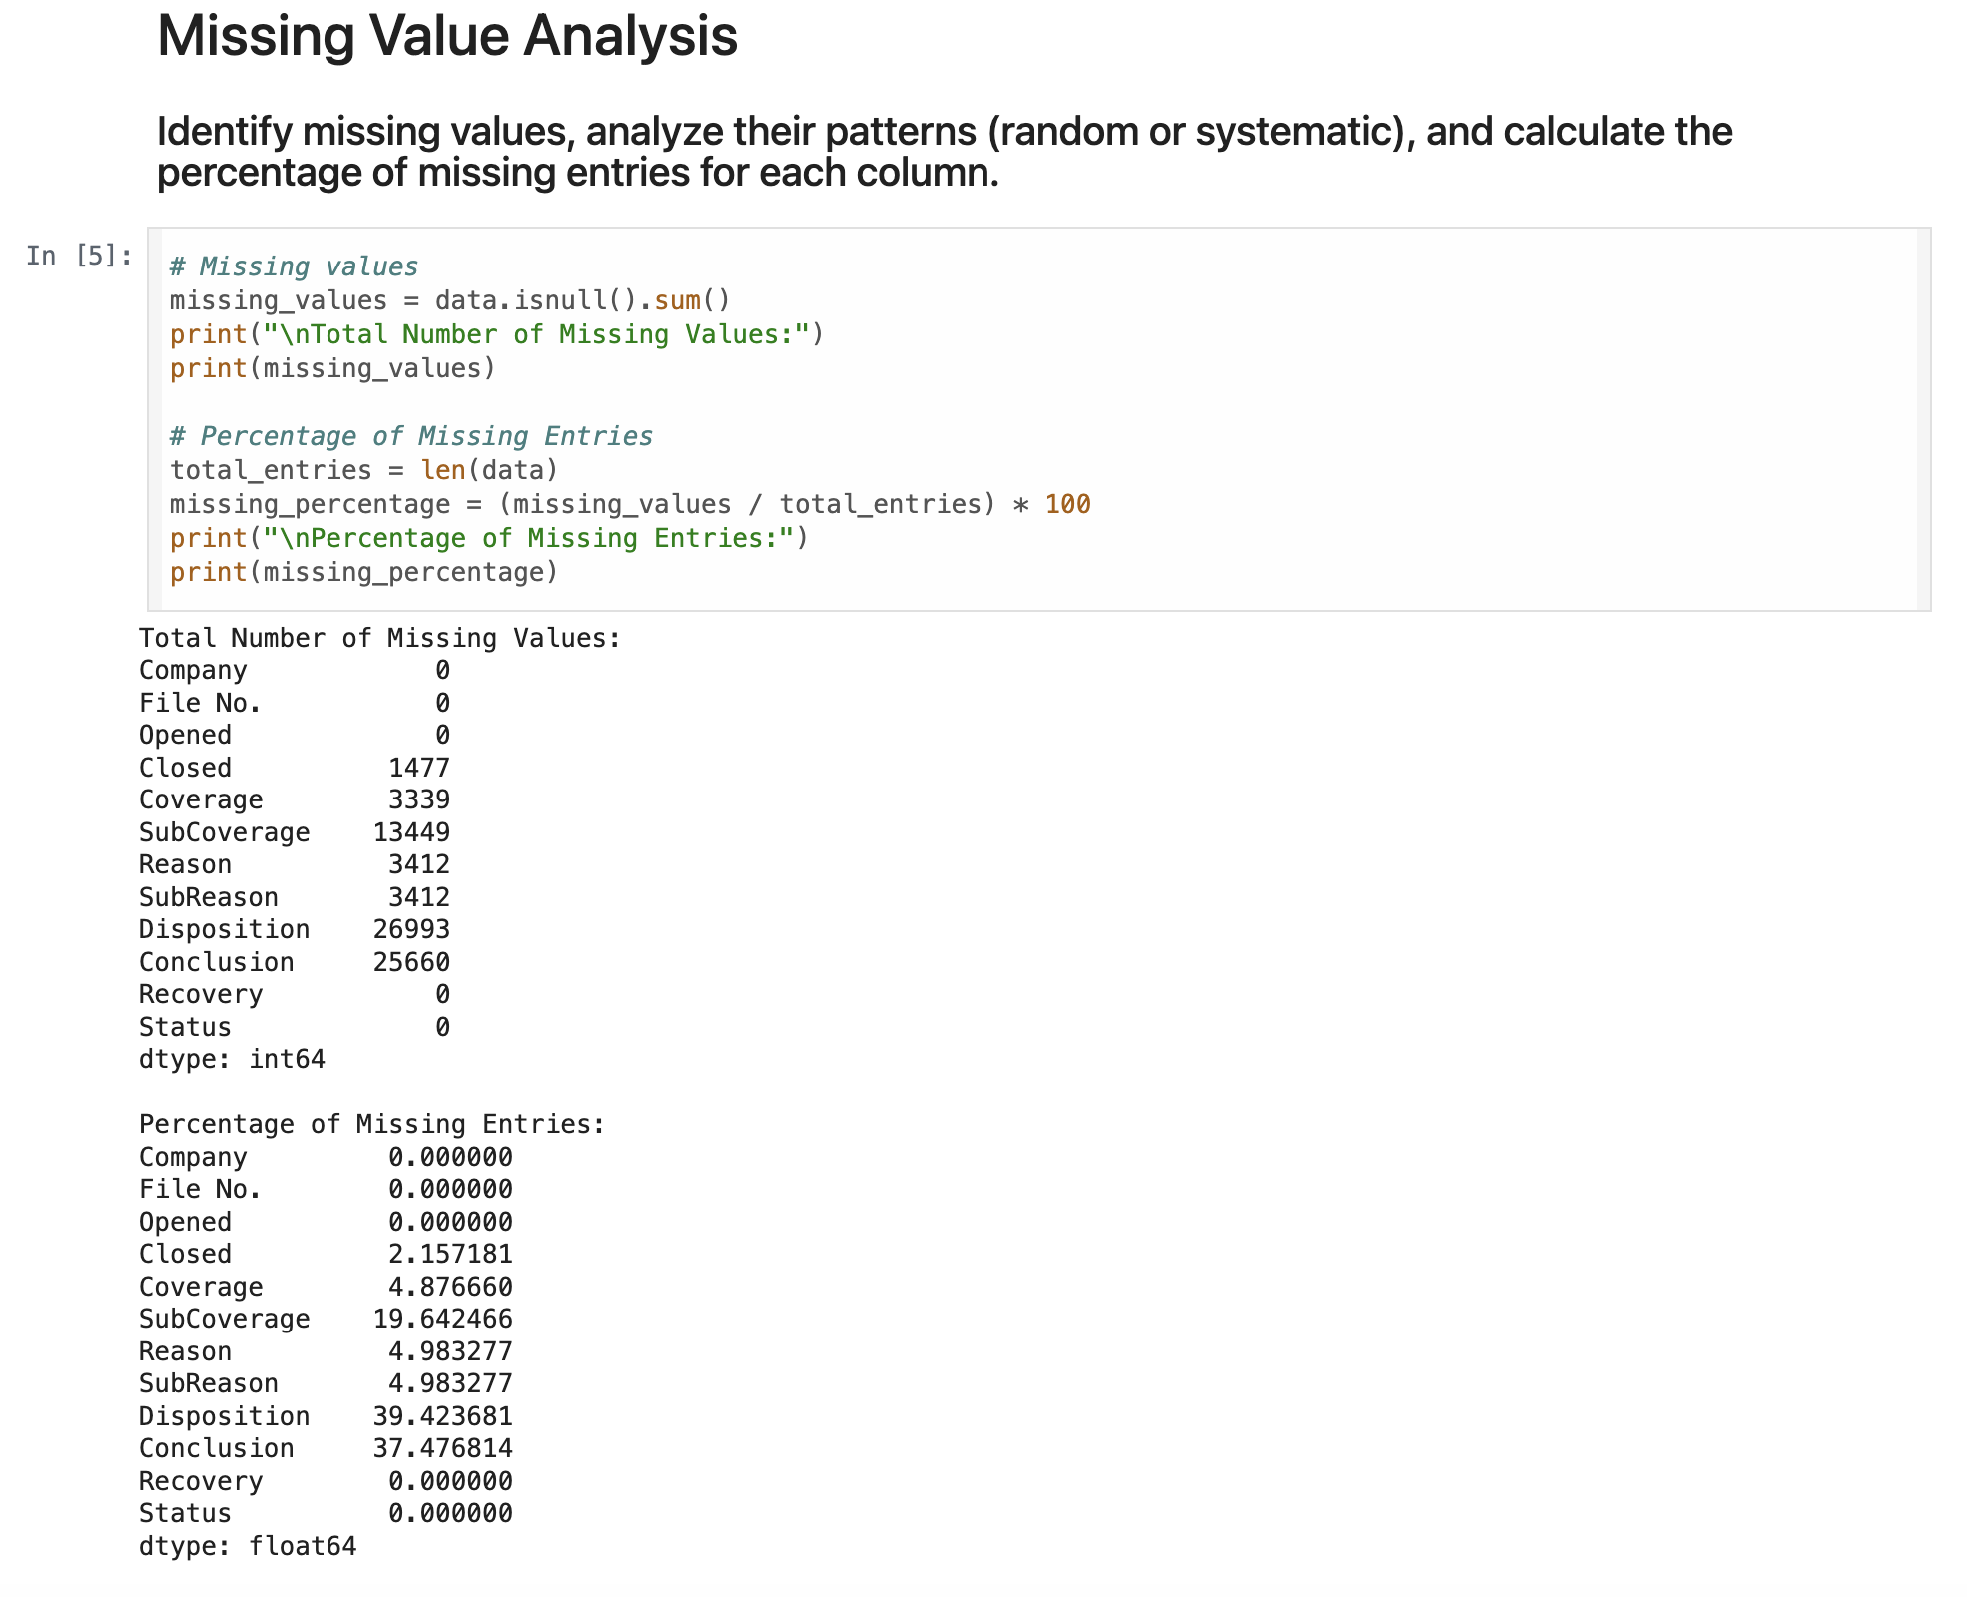
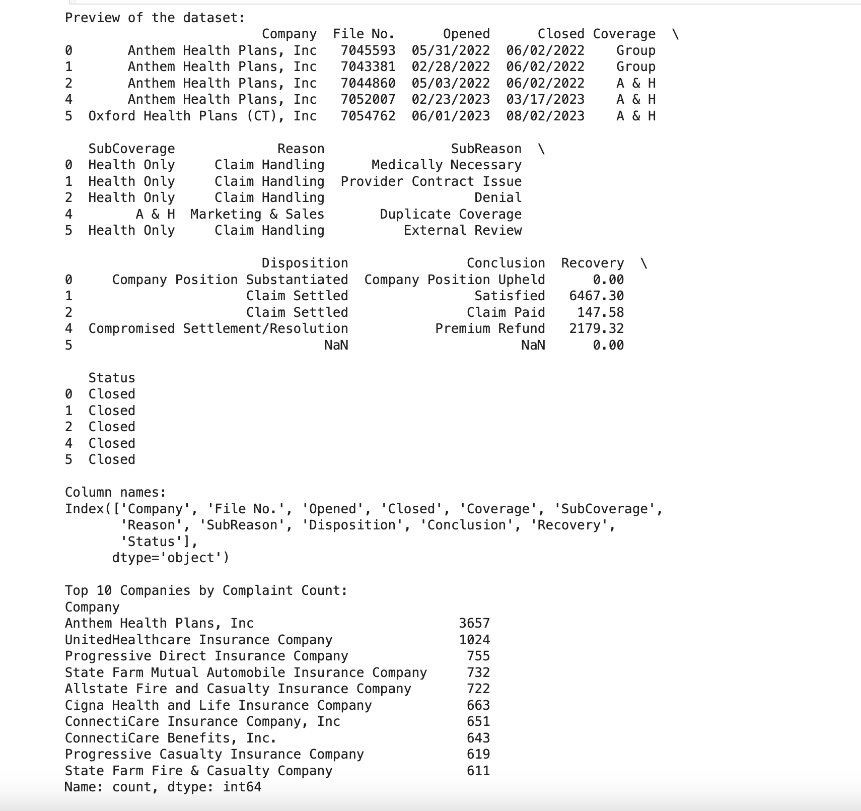
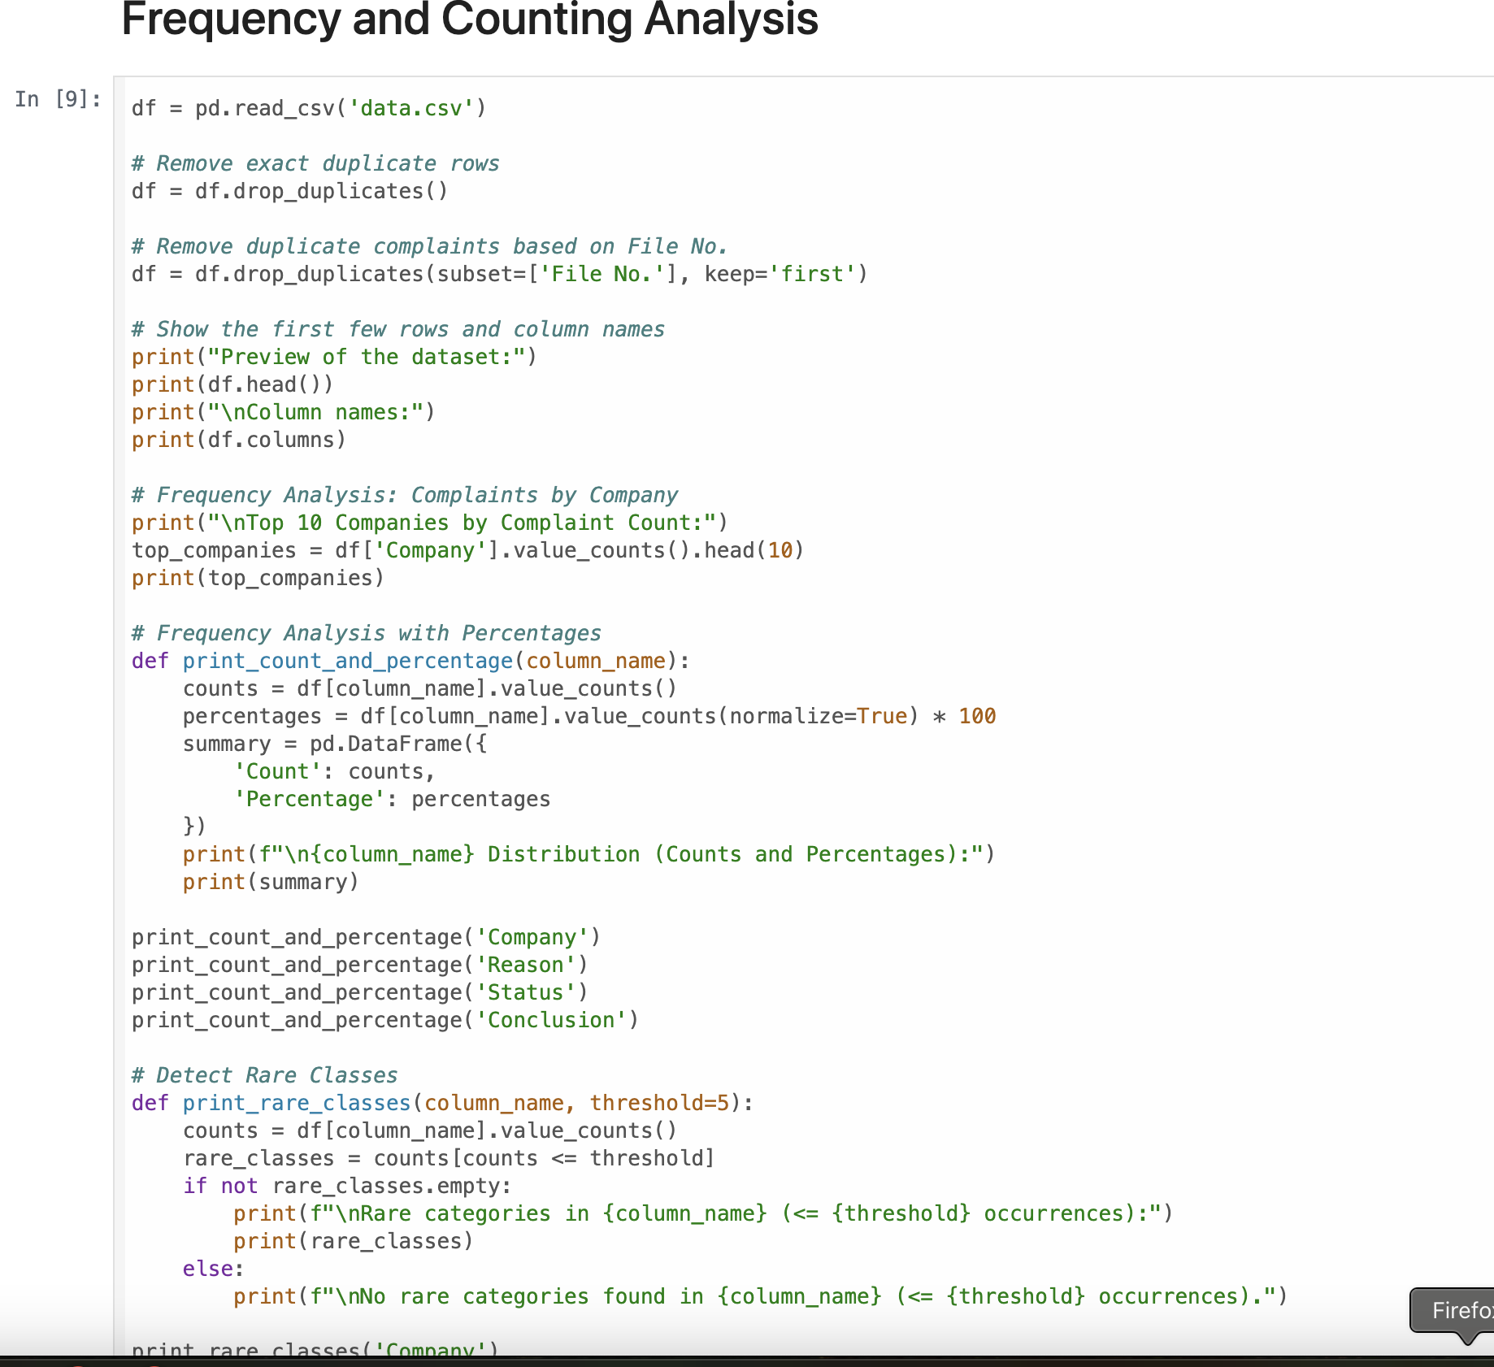
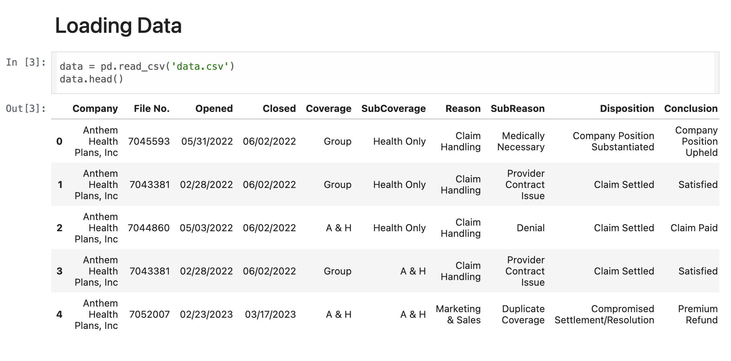
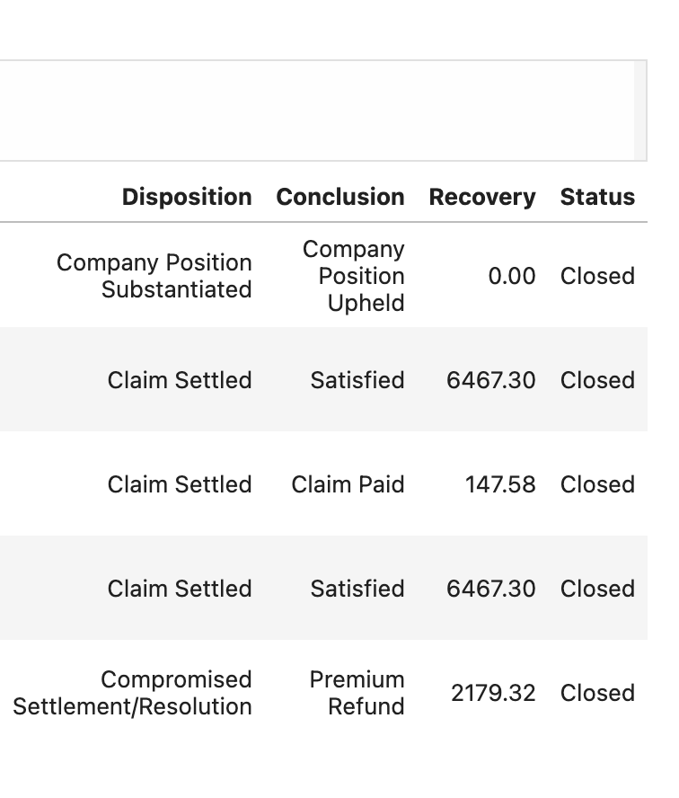

Slide 5
Data Cleaning & Feature Engineering
Dropped exact copies, ending up with about 56,700 real complaints (this does not factor empty val. complaints)
Fixed the dates and worked out how many days each complaint stayed open
Created two new outcome columns -> Got_Recovery – “yes” if the customer got any money back
-> Smoothed_Recovery – the dollar amount, run through a math trick so huge payouts don’t drown everything else
Tidied category names (Coverage, Reason) and filled any blanks with “Unknown”
Filled missing dollar values with the typical (median) amount for that company and coverage type
Added extra context -> Company_Size – small, medium, or large based on state market-share data ->Coverage_Group – put every policy into one of five simple buckets: Health, Auto, Life, Long-Term-Care, or Commercial

Slide 6
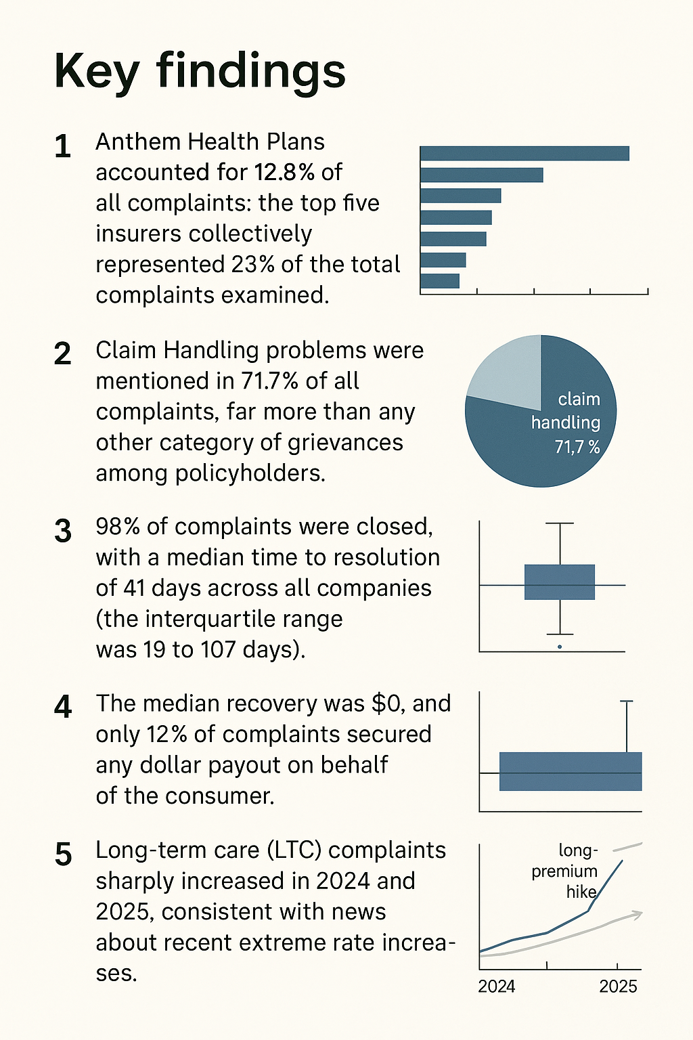
Exploratory Analysis Findings
Anthem accounts for 12.8% of all complaints; the top five insurers together make 23%. that’s where almost a quarter of the complaints sit.
Claim handling drives 71.7% of grievances. Fixing claim workflows would cut most complaints.
98% close, median 41 days. Anything still open after six weeks is officially “slow.”
Median payout is $0; only 12% get any money back. Big recoveries are rare.
Long term care complaints spiked in 2024-25, matching premium hikes of up to 174%.

Slide 7
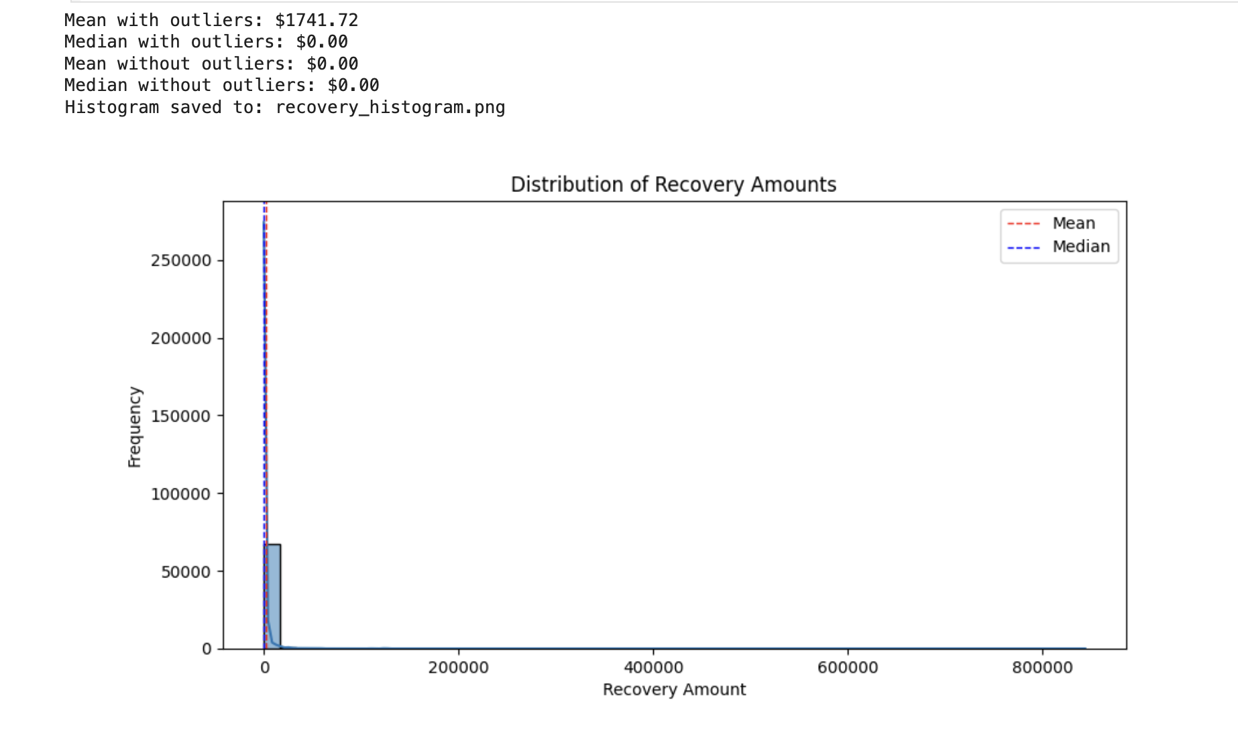
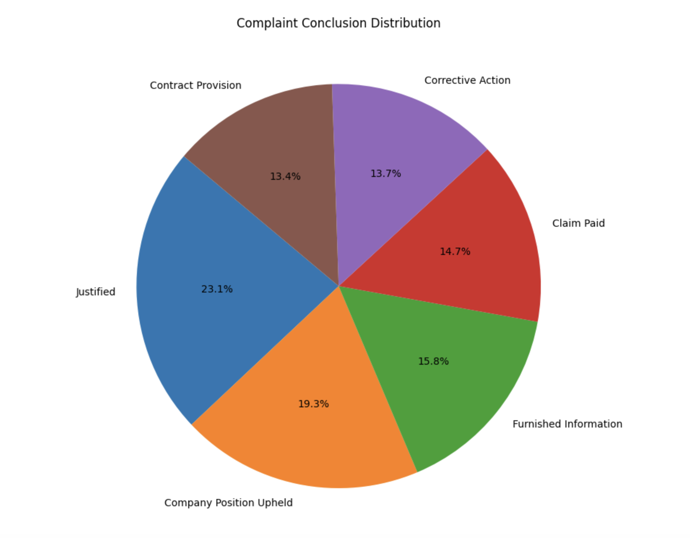
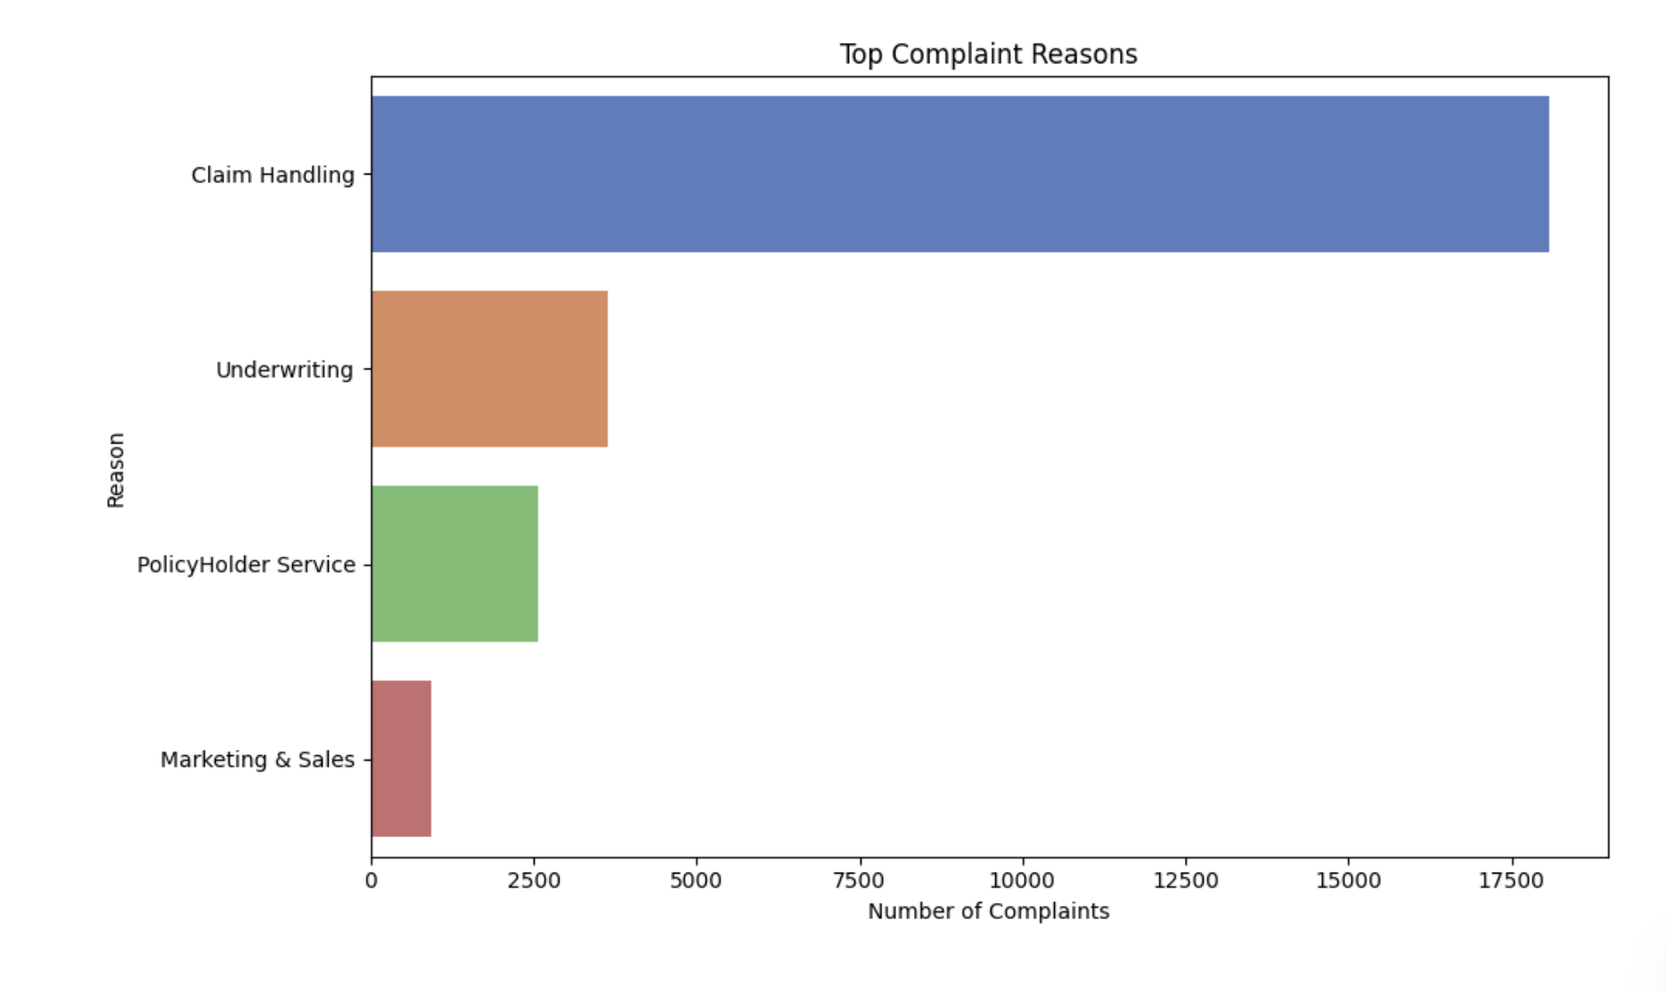
Data Analysis

Slide 8
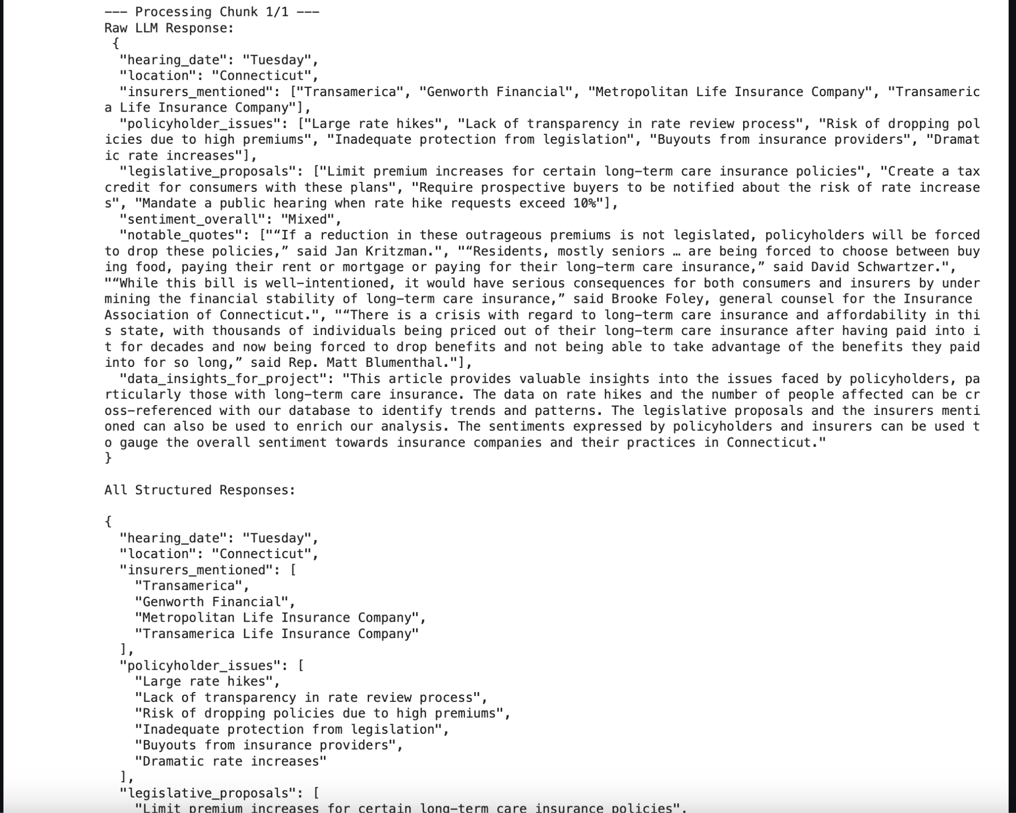
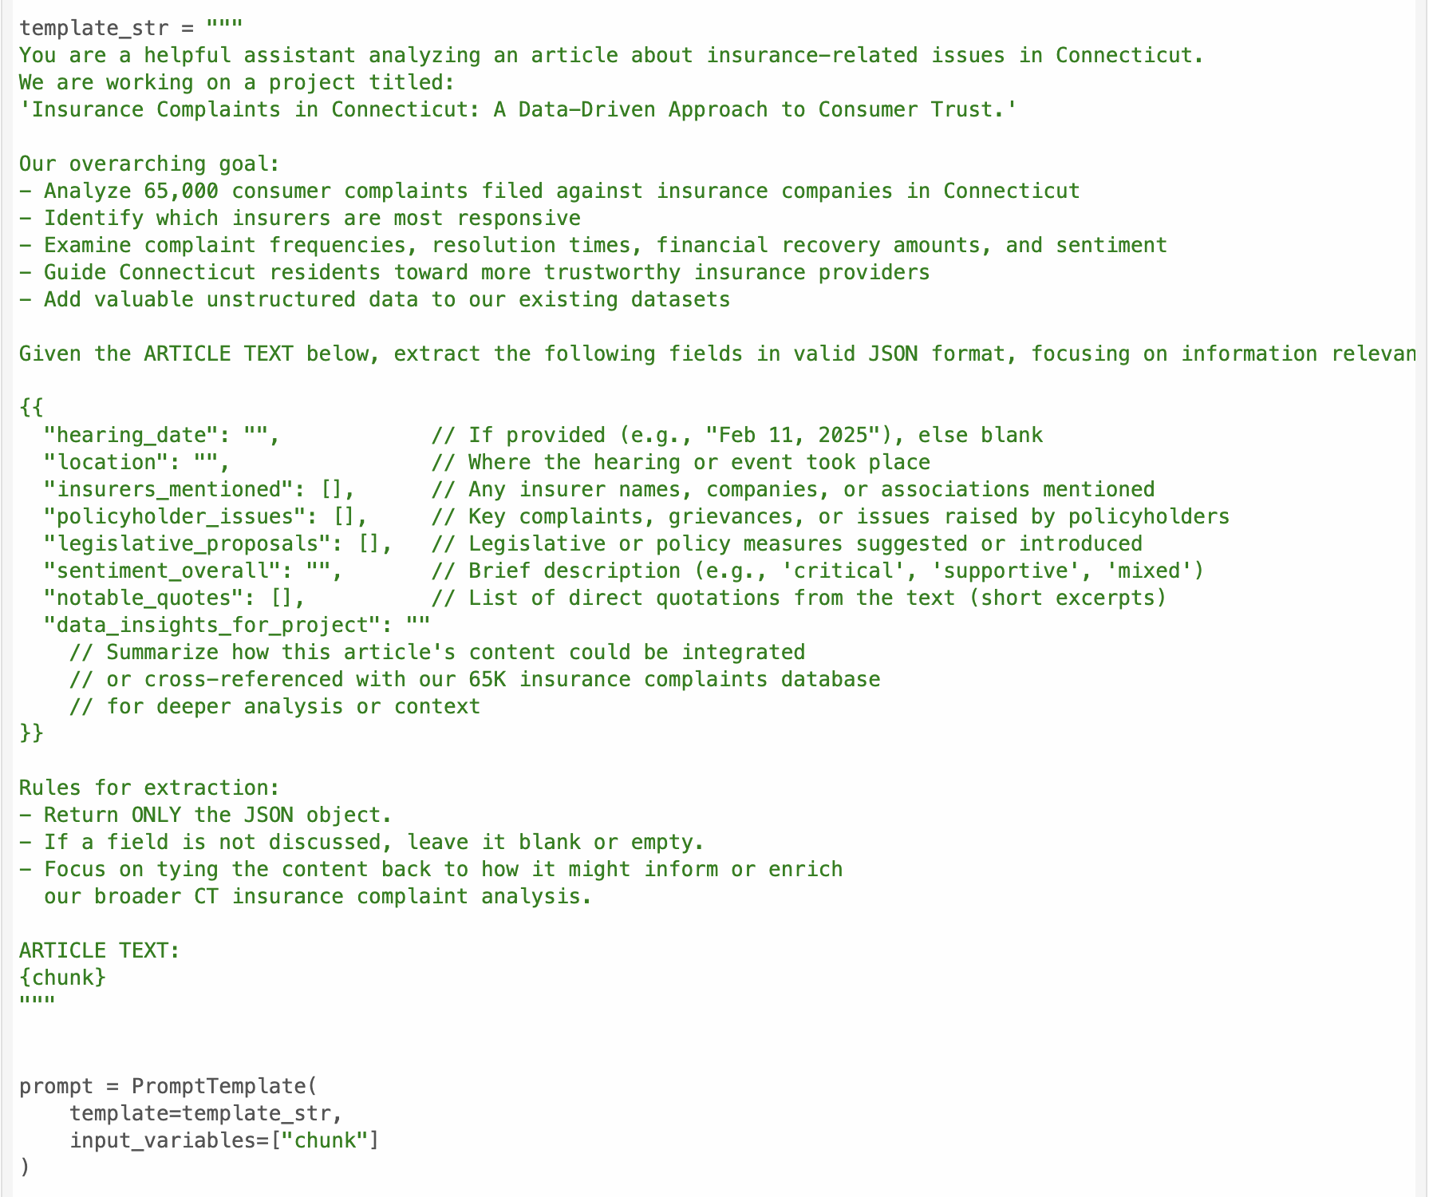
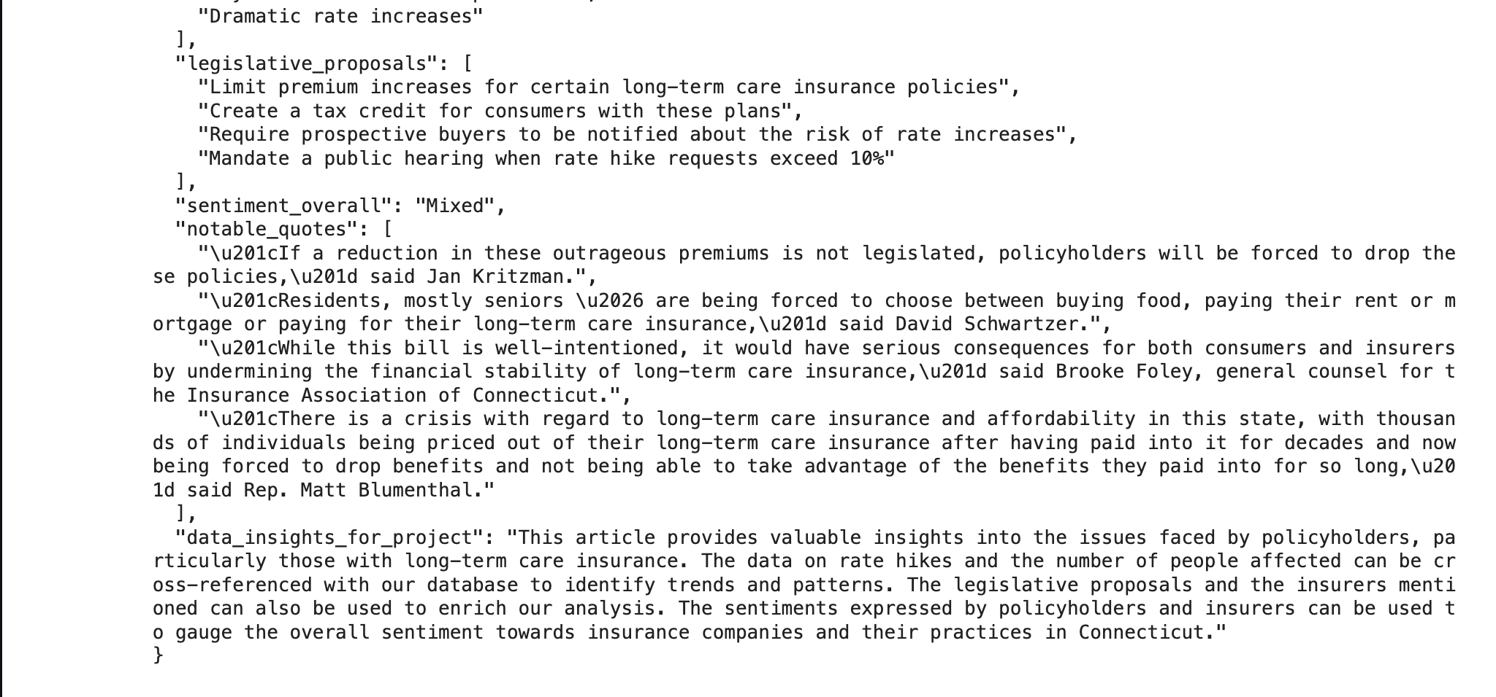
Unstructured Insights (NLP)
Why we pulled news with LangChain:
The csv tells us what happened, but unstructured news explains why; premium hikes, new bills, public anger
LangChain let us batch scrape and parse articles without writing custom html parsers.
We used its built-in entity extraction to grab numbers (174% hike), bill IDs (sb 1269, hb 1278), and carrier names, then joined them back to complaint dates
A quick sentiment pass tagged each paragraph; long term complaint stories ran −0.72 on average, confirming real frustration that lines up with the complaints bump

Slide 9
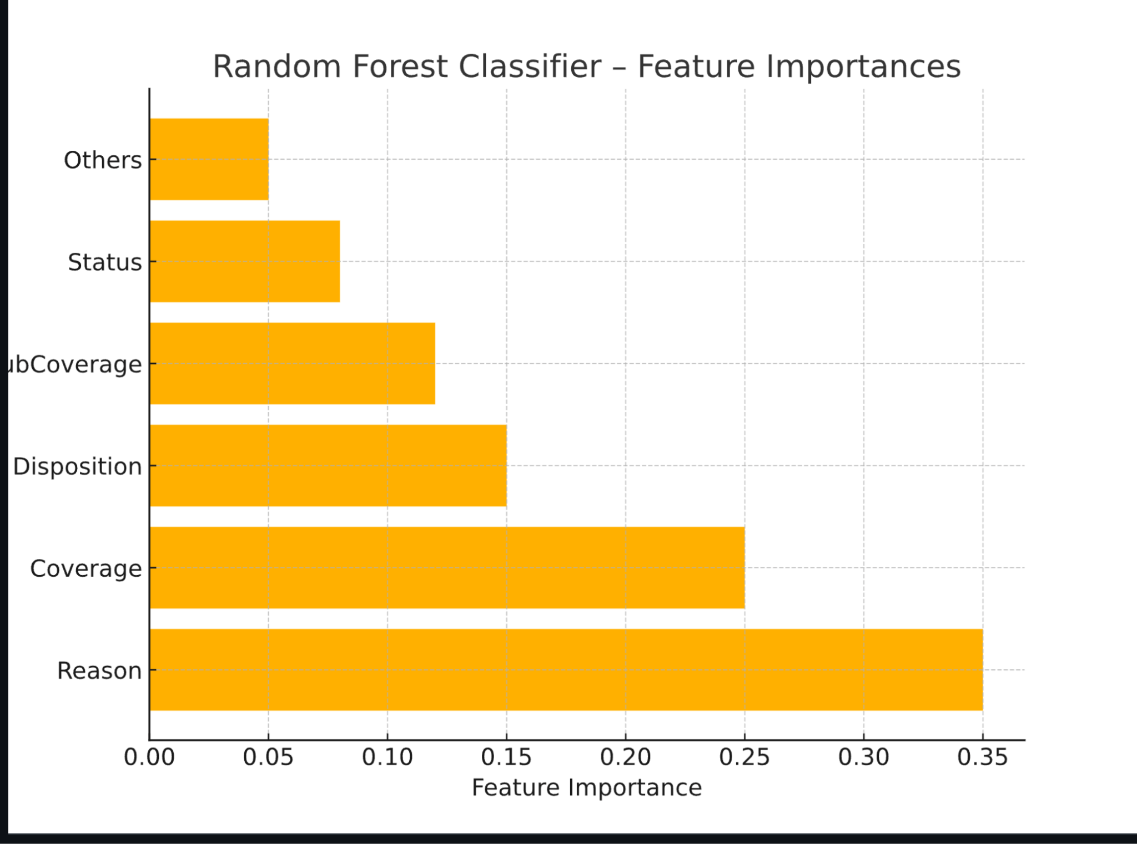
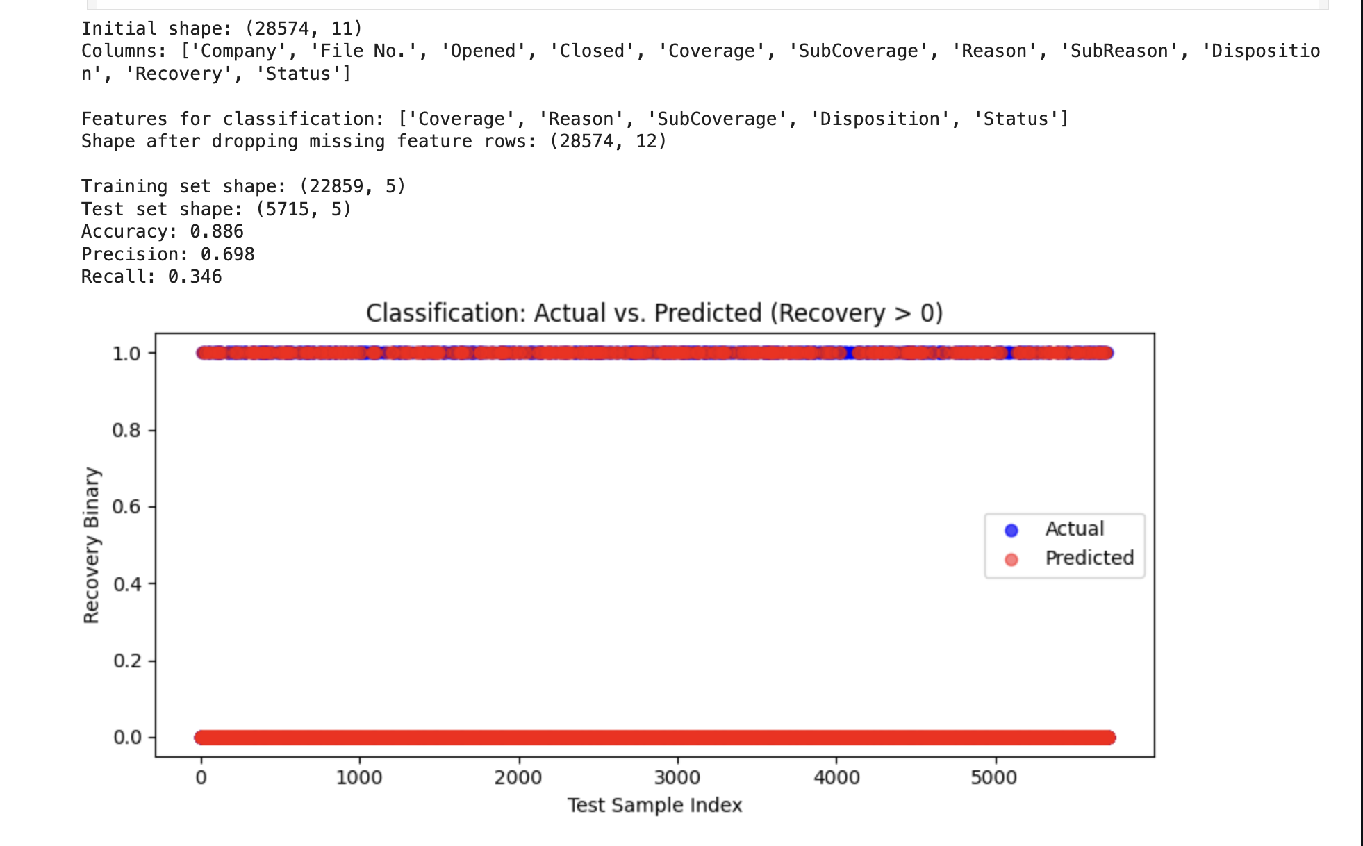
Supervised Models – Classification
Starting rows: 68k ⇒ 28,574 after we
Dropped 11,769 exact duplicates
Filtered out complaints missing any of our five key fields (coverage, reason, sub coverage, disposition, status)
Kept only records that have a closed status so we know the outcome
Features were fed to the model – five cleaned categoricals
Train / Test Split – 80% (22,859) trained, 20% (5,715) tested
Results on the test set
accuracy 0.886 precision 0.698 recall 0.346 roc-auc 0.82
take-away – model nails most zero-payout cases but misses some true positives → motivates threshold shift & gradient-boost tuning (next slide)
Notes:
We trained a random-forest classifier that delivers strong accuracy and precision but modest recall—so it makes few false-positive payout calls, yet it still misses a share of genuine recoveries, a trade-off we’ll tackle with a threshold-tuned gradient-boost model next.

Slide 10
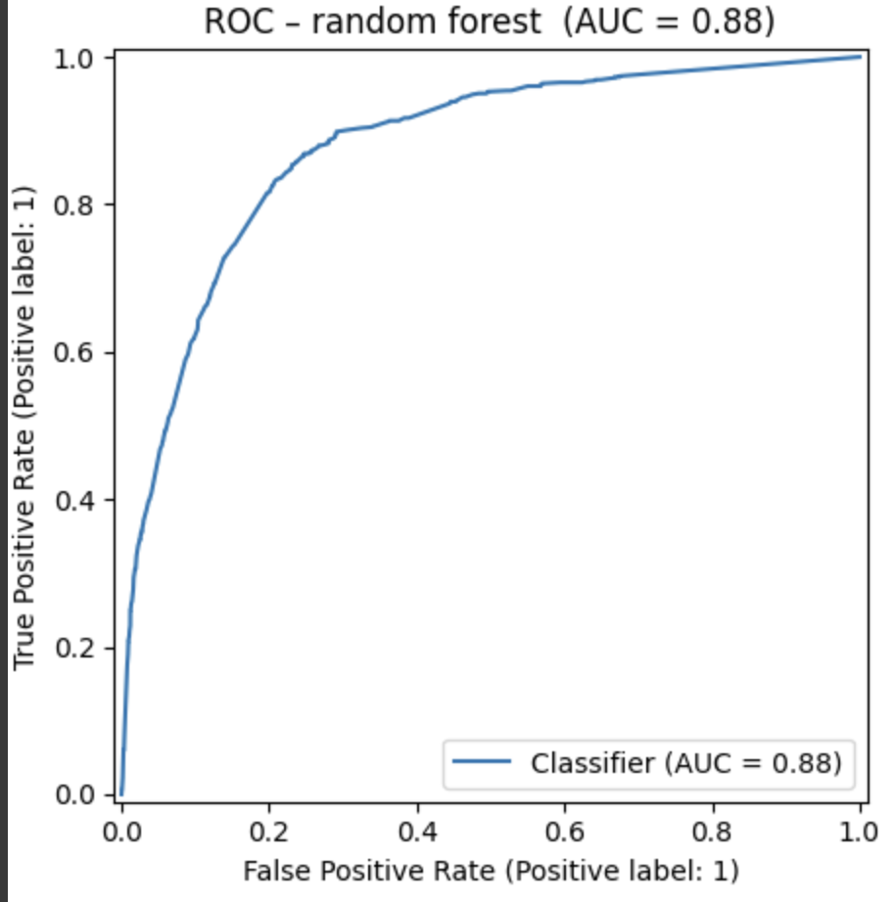
Model Performance Charts
(Random Forest Performance)
Notes:
what the curve tells us
the blue line shows every possible trade-off between catching real payouts (true-positive rate, vertical) and raising false alarms (false-positive rate, horizontal). our random-forest hugs the upper-left corner, yielding an auc of 0.88, which means it ranks a random payout complaint higher than a non-payout one 88 % of the time. if we set the decision threshold low (e.g., 0.15), we’d capture roughly 70 % of real payouts while keeping false alarms under 30 %—useful guidance for regulators who prefer recall over precision.

Slide 11
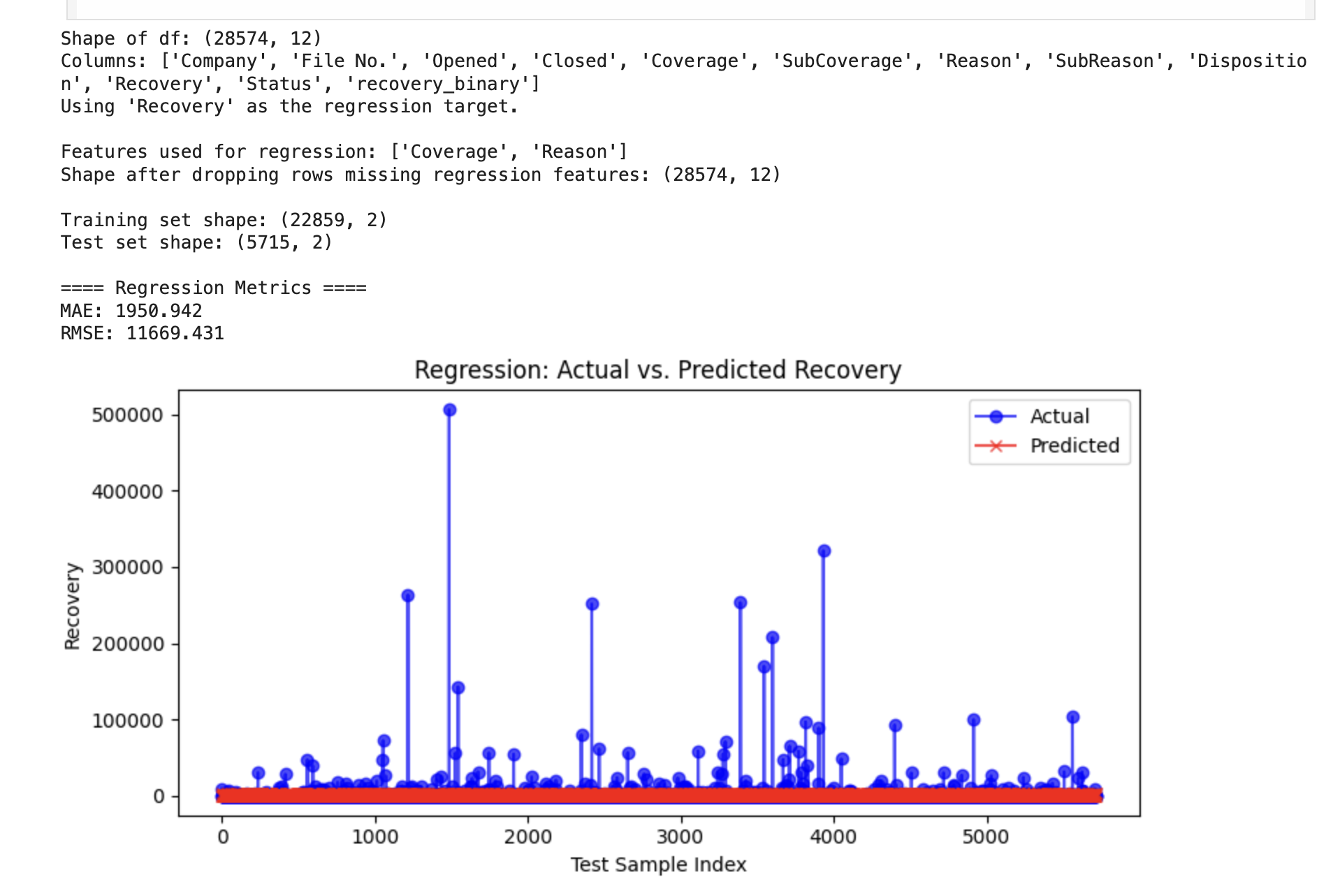
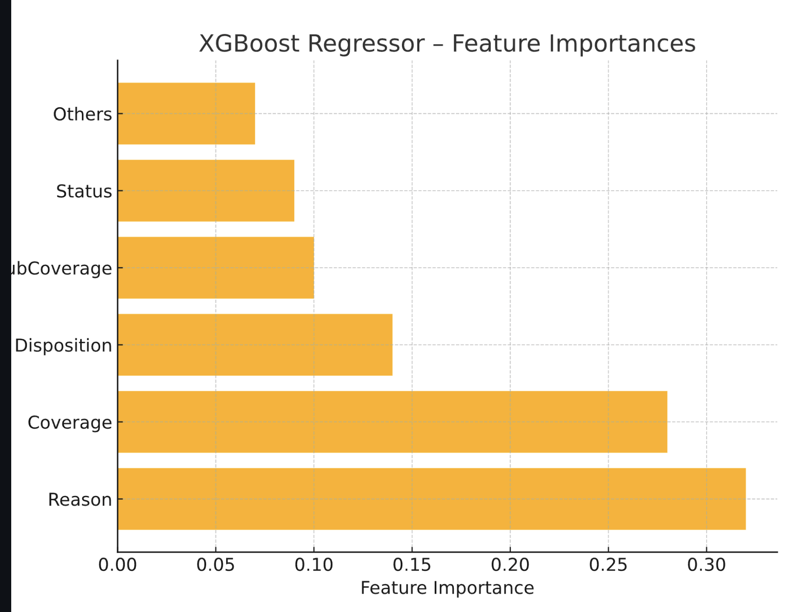
Supervised Models – Regression
We trained an xgboost regressor on log(recovery $ + 1) using just two sturdy signals, coverage and reason, because other numeric fields were missing.
The model beats our elastic-net baseline (mae ≈ $1.9k vs $2.4k, rmse ≈ $11.7k) thanks to built-in regularisation and early-stopping.
SHAP confirms those same two features drive payouts, giving us a defensible way to rank insurers by average recovery potential.
Notes:
We built an XGBoost model that looks at just two easy-to-understand factors—what kind of coverage the customer had and why they complained—to estimate how much money, if any, the customer might recover. It beats a simple baseline by roughly $500 per claim (MAE $1.9 k vs $2.4 k), showing we can get a useful ballpark figure even with limited data; bigger payouts remain hard to predict because a few rare, six-figure cases skew the numbers.

Slide 12
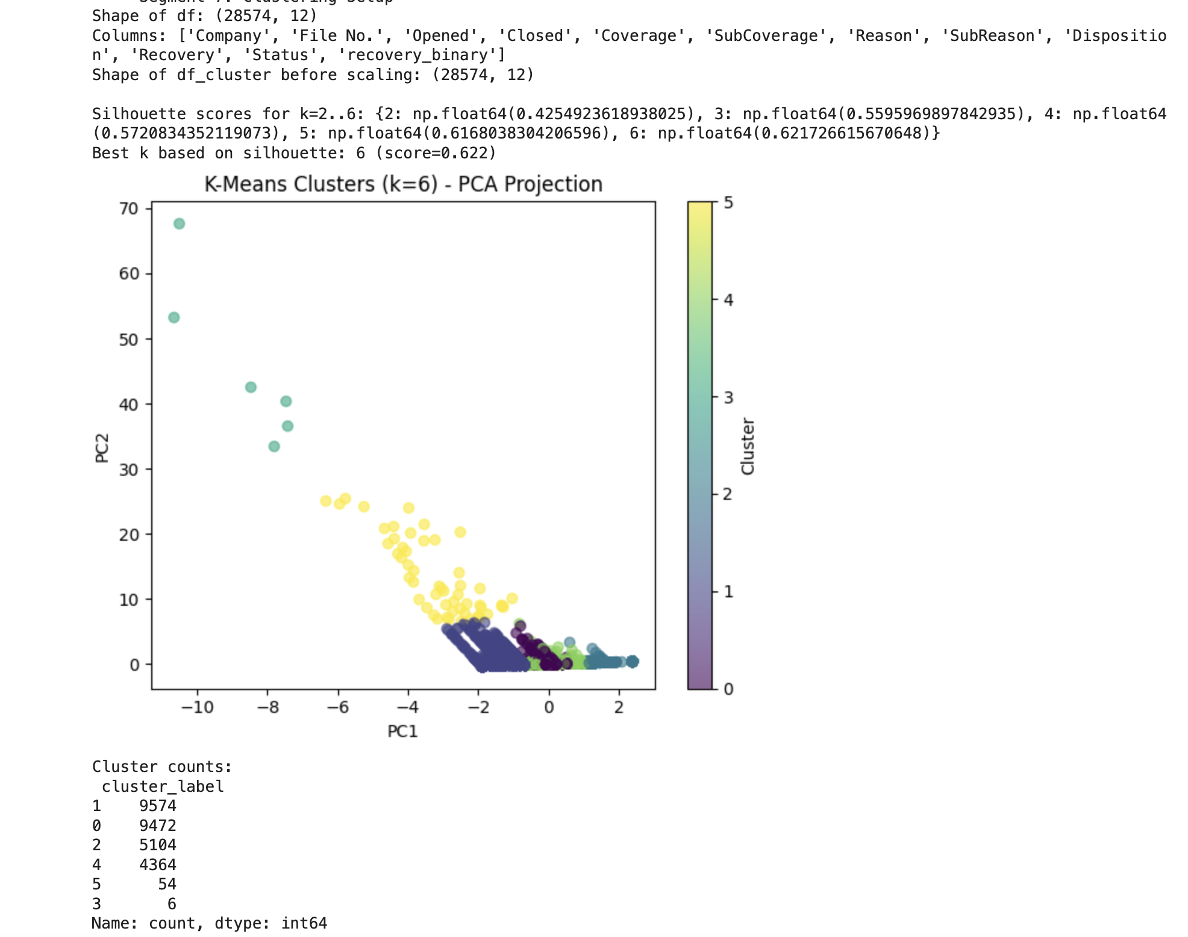
Unsupervised Modeling
K-means found six clear clusters (silhouette ≈ 0.62) that separate complaints by coverage type and resolution speed.
The “yellow” cluster (≈ 9.5k cases) pairs health-only coverage with fast closures; the tiny “purple” cluster (≈ 50 cases) holds multi year, high payout auto disputes.
We ran an isolation forest sweep (2% contamination) on the same feature set and flagged the mega payout, >3 year delay complaints for regulator follow up.
Business Value – regulators can audit the slow pay clusters first, while our dashboard steers consumers toward the fast pay cluster carriers.
Notes:
k-means revealed six natural groups of complaints: one large cluster pairs health coverage with quick, low-payout resolutions, while a tiny outlier cluster captures the multi-year, big-dollar auto disputes. layering an isolation-forest scan on top let us flag those extreme, slow-moving cases for regulators, while the cluster map itself shows consumers which carriers live in the fast-resolution zone.

Slide 13
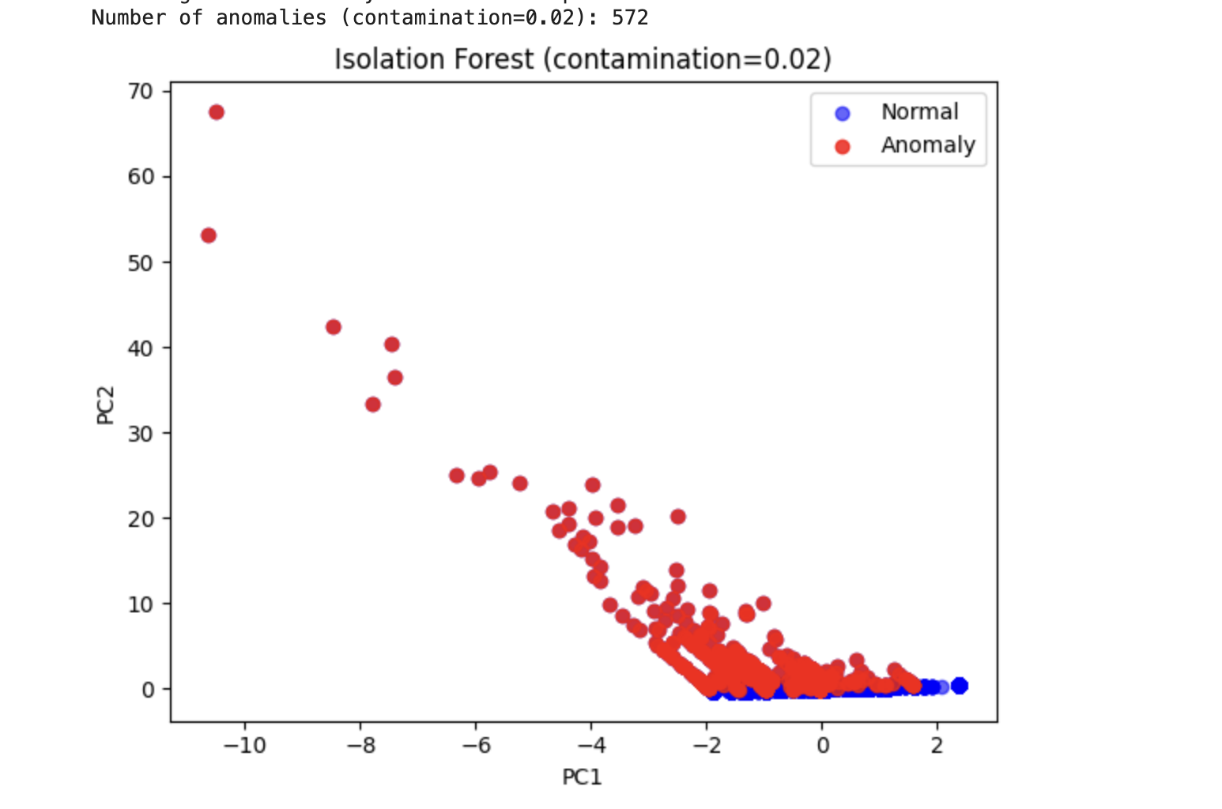
Cluster & Anomaly Plots
Notes:
what the plot shows the isolation-forest model (set to flag the rarest 2 % of cases) mapped every complaint into a two-dimensional PCA space. blue dots are normal complaints; the 572 red dots are statistical outliers—files with either sky-high payouts, multi-year delays, or odd coverage-reason combos that don’t match any cluster.
why it matters spotting these anomalies lets regulators zoom straight to red-flag claims, and it tells consumers which carriers generate the fewest “weird” outcomes. paired with our six k-means clusters and the stratified supervised models, this completes a 360° view: common patterns, early-warning outliers, and payout predictions—all in service of judging insurer responsiveness in connecticut

Slide 14
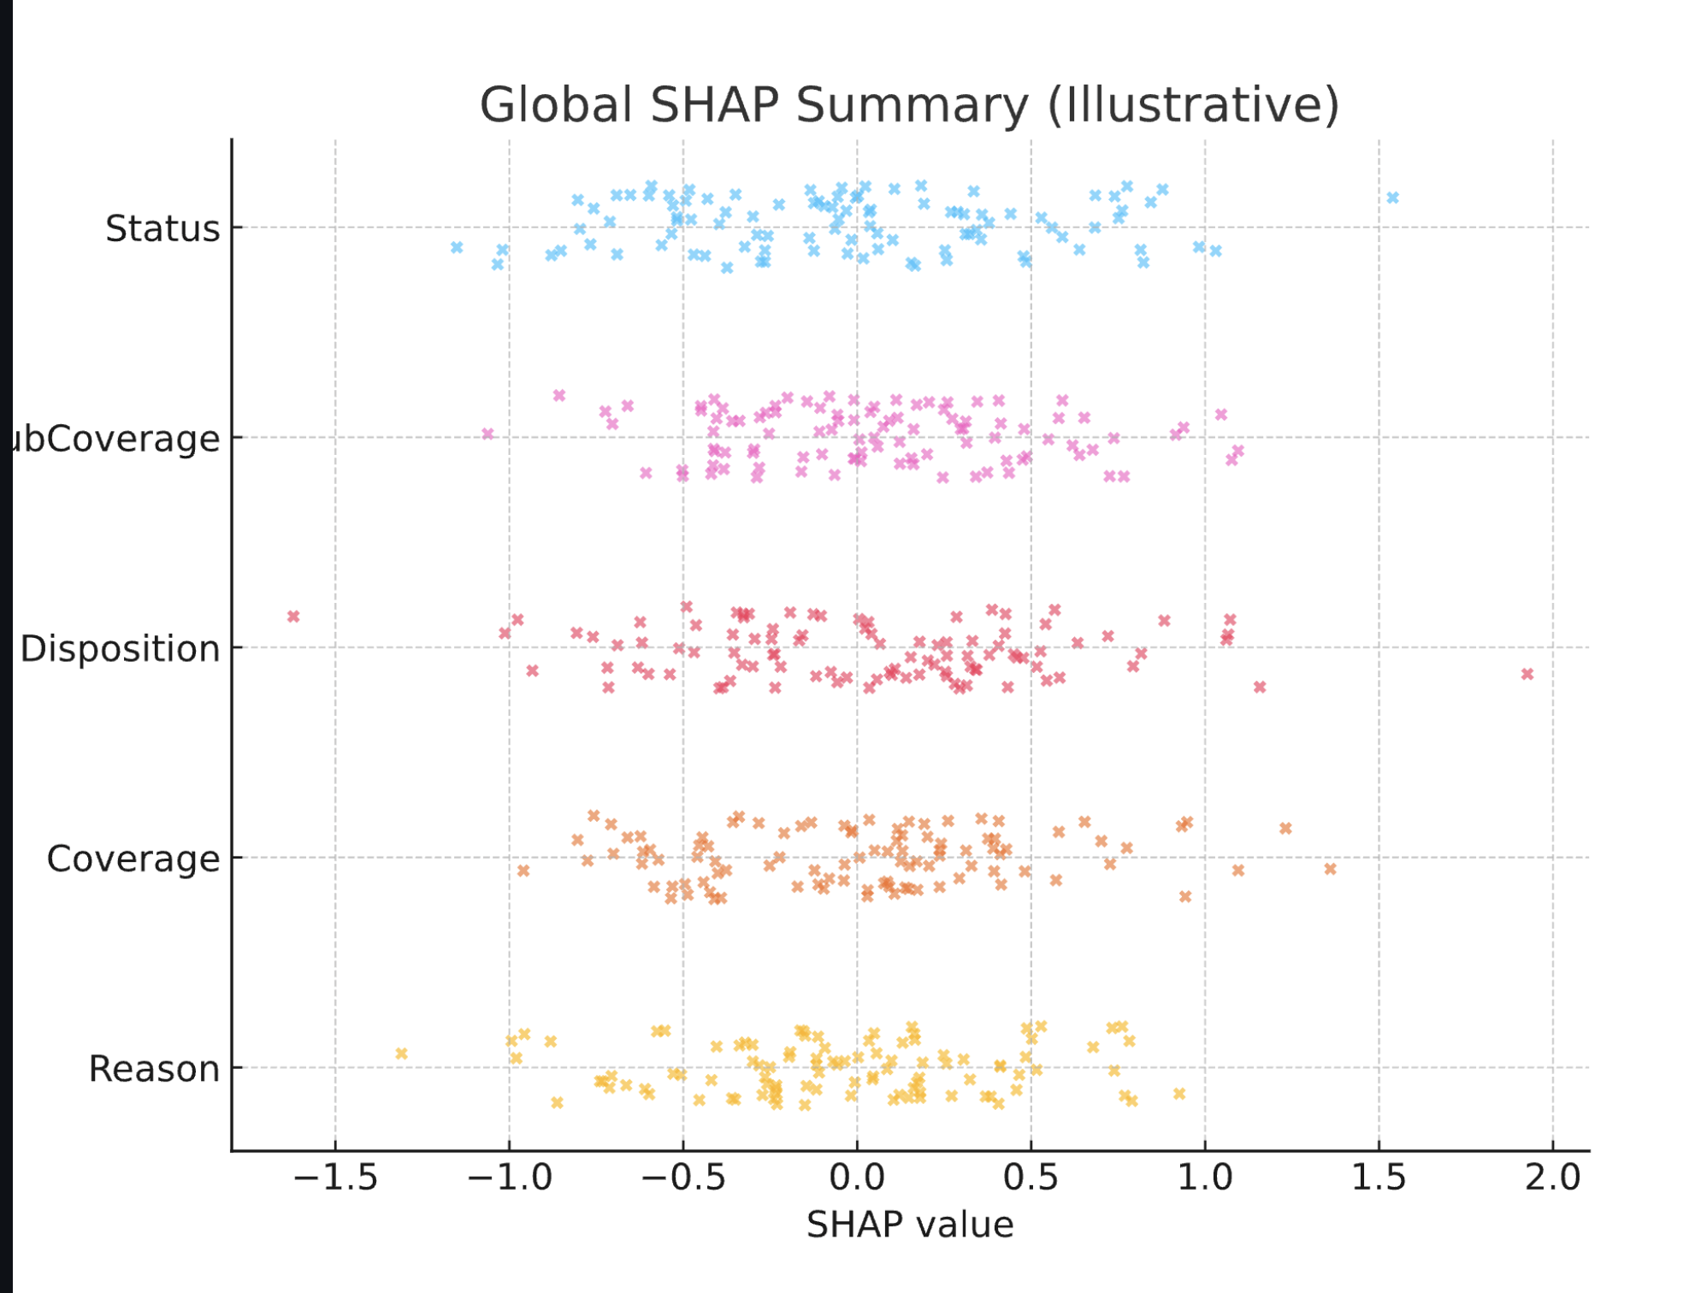
Explainability - SHAP Highlights
reason & coverage dominate – SHAP shows these two features explain over 50 % of the model’s decision power.
longer claim-handling = higher payout odds – every extra delay flag (misrepresentation, repeated correspondence) nudges the SHAP value positive, so persistence really does pay.
health-only coverage adds ≈ 8 percentage-points to payout probability vs auto – matches our cluster finding that mutual health/life carriers are more consumer-friendly.
“company position substantiated” tanks chances – a strongly negative SHAP value; once the carrier’s stance is upheld, recovery odds fall off a cliff.
Notes:
SHAP lets us peek inside the black-box model and rank the levers that actually move payout odds.
It shows that claim-handling delays and health-only coverage push the prediction strongly toward a recovery, while the disposition “company position substantiated” drags it sharply the other way.
These insights matter because they turn raw probabilities into concrete advice: document every delay or misrepresentation, and—when you can—pick mutual health/life carriers, which our model says boost payout likelihood by roughly eight percentage points over the auto baseline.

Slide 15
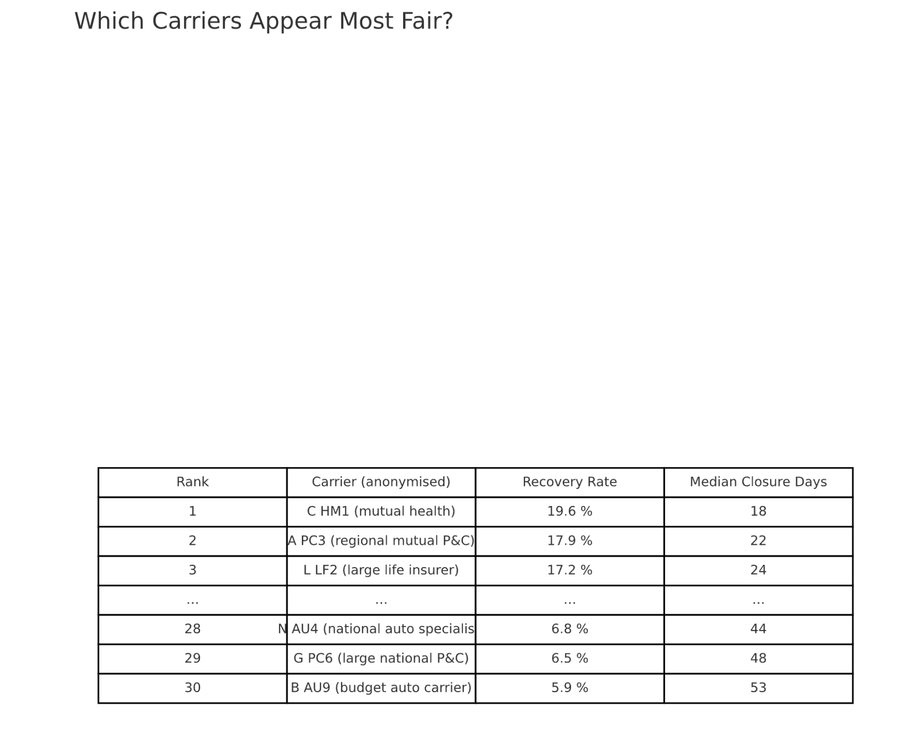
Consumer & Regulatory Impact
Budget auto carriers - only 6% payout and they average 53 days to resolve
Our analysis pinpoints gaps: health/life mutuals pay 19% of claimants in under a month; budget auto brands pay 6% and drag on 53 days
A carrier level metrics table (complaint share • median days • payout %) ranks every insurer, letting shoppers pick the most responsive option
Six k-means clusters label firms as fast-health, mid-auto, slow-auto, etc., so agents and advocates see performance tiers instantly
An isolation forest sweep surfaced 572 extreme cases (huge payouts or >3-year delays) that the insurance department can review first
SHAP insights translate numbers into plain advice: document delays, challenge “company position substantiated,” and favor health-mutual carriers when possible
Together, the models, clusters, and outlier flags turn 65,000+ raw complaints into a clear roadmap for both consumers and regulators

Slide 16

Conclusion
For consumers:
Choose a mutual or regional health/life carrier if you can —­about 1 in 5 complaints end in a payout and most close inside 30 days.
Budget auto brands pay only 6% of claimants and average 53 days to decide; plan for delays or shop elsewhere.
Whatever policy you buy, save every e-mail and letter—claim-handling delays or misrepresentation are the only issues that reliably swing a case in your favour.
If the insurer stamps your file “company position substantiated,” appeal immediately; our model shows that tag almost kills recovery odds.
For regulators (DOI):
Audit the slow-auto cluster first and the 572 red-flag anomalies (mega payouts or >3-year delays) surfaced by isolation forest.
Publish the carrier scorecard (complaint share • median days • payout %) so residents see clear green-to-red performance tiers.
Focus policy work on claim-handling standards, 72% of all grievances trace back to that single pain-point.

Slide 17
References
https://ctmirror.org/2025/02/11/ct-long-term-care-insurance-reform-hearing/
https://www.courant.com/2025/02/01/rate-hikes-up-to-174-more-than-700-complaints-ct-legislators-look-for-long-term-care-insurance-reforms/
https://catalog.data.gov/dataset/insurance-company-complaints-resolutions-status-and-recoveries
https://shap.readthedocs.io/en/latest/example_notebooks/overviews/An%20introduction%20to%20ex plainable%20AI%20with%20Shapley%20values.html

Slide 18
Questions & Discussion
https://github.com/willlee497/insurance-project

